Slide 1
Doodles from #StrongerTogether: SSAH and the future of evidence-informed policymaking
Created by Joyce Van Kerckhove, Author at Visuality

Slide 2
#StrongerTogether: SSAH and the future of evidence-informed policymaking DAY 1
#StrongerTogether: SSAH

Slide 3
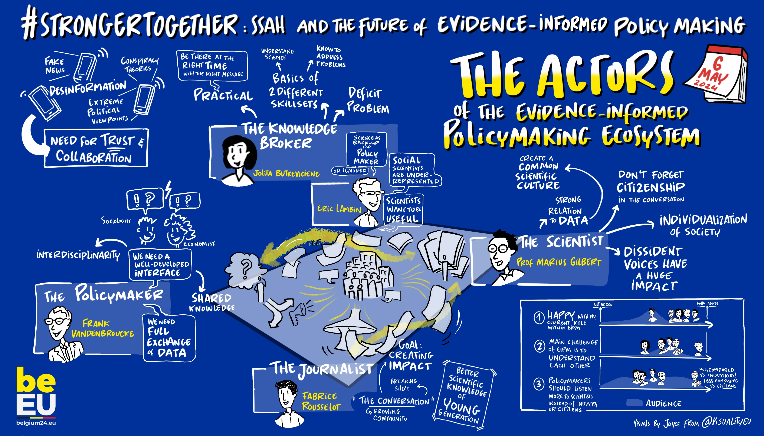

Slide 9
#StrongerTogether: SSAH and the future of evidence-informed policymaking DAY 2
#StrongerTogether: SSAH

